Slide 1
Data Visualizations
File created on: 12/18/19 2:08:10 PM EST

Slide 2
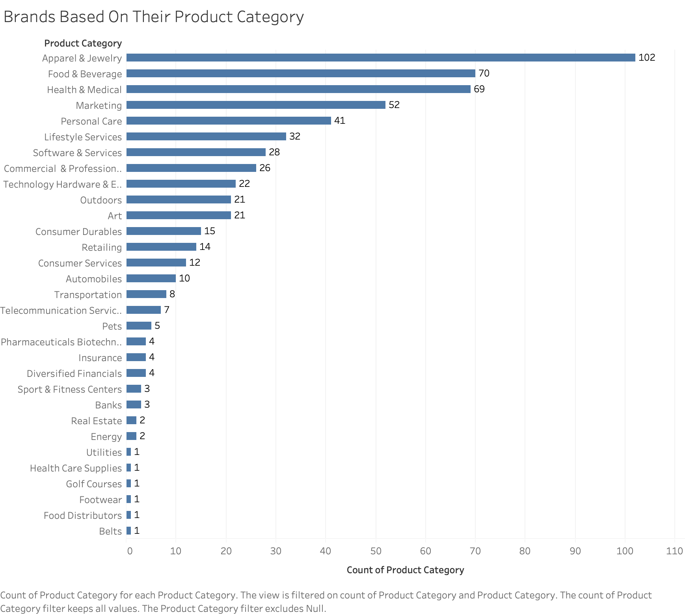
Notes:
As we can see from the graph, the Apparel & Jewelry Brands had the highest rate of not upgrading to a paid subscription, by far. Based on this raw data alone, we can assume that this category of brands is the least interested in what Opensponsorship has to offer. That being said, this data does not reflect those brands that created an account and did upgrade to a paid subscription.
If we had a percentage of total accounts, it would be a better indicator than the sum of brands that didn’t upgrade.

Slide 3
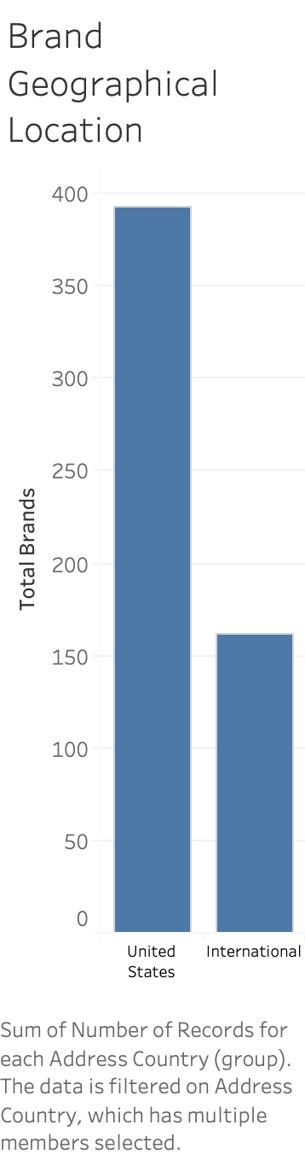
Notes:
Based on the raw data, most brands that did not upgrade to a paid subscription are domestic companies. Similarly to the ”Product Category” chart, it is difficult to make an assumption without have the data with the total brands that created an account. Yes, drastically more domestic brands didn’t upgrade, but what is that sum tell us relative to the total?

Slide 4
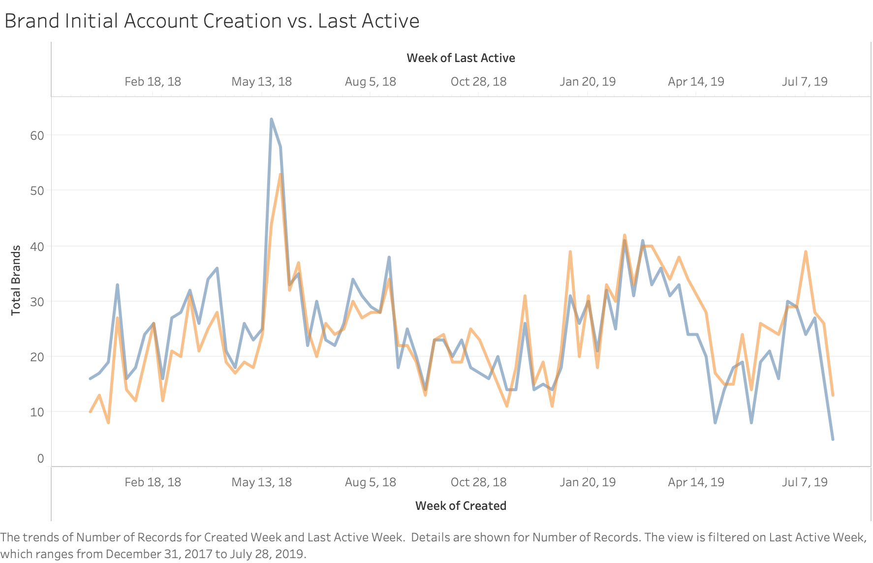

Slide 5
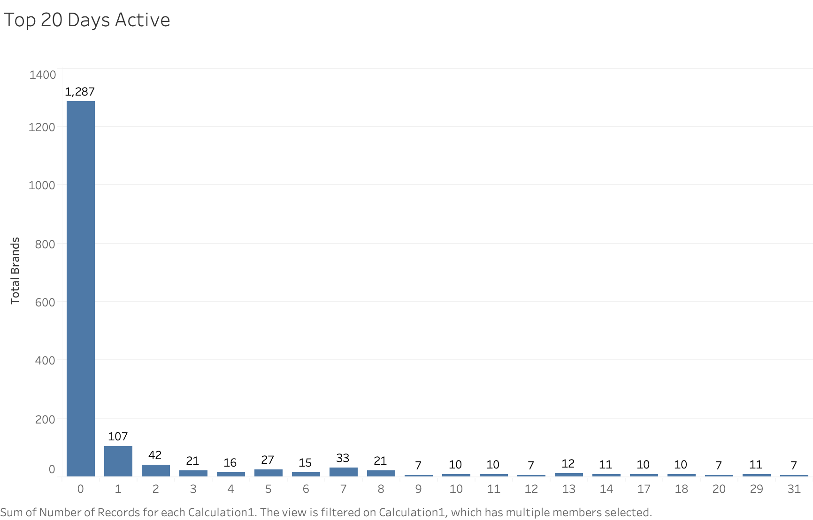

Slide 6
